Slide 1
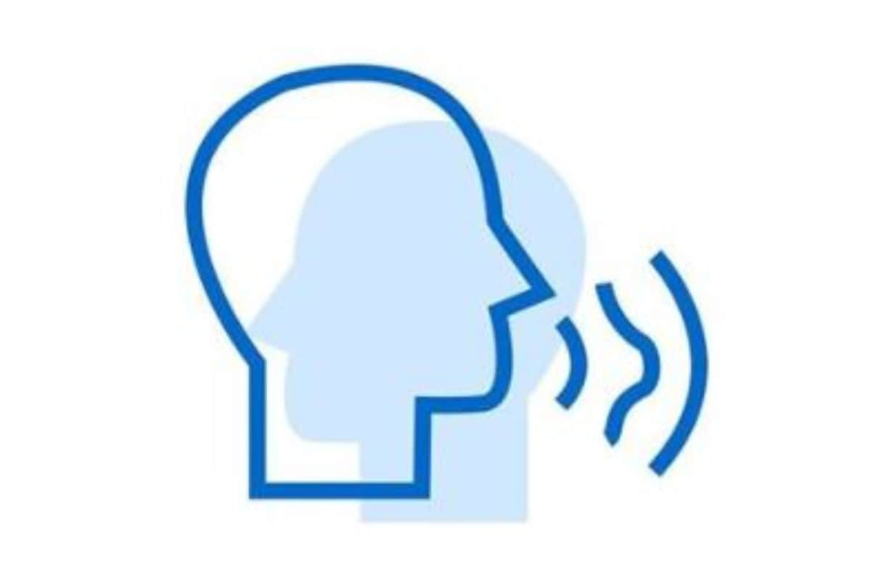
Jitter and Shimmer in speech
Presented by :
Kruthika S Vasisht

Slide 2
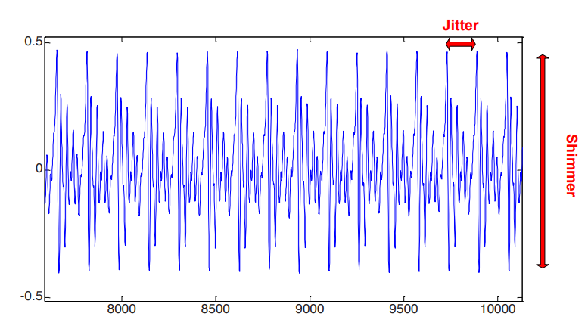
What is jitter and shimmer?
Jitter and shimmer represent the variations that occur in the Fundamental frequency[Fo].

Slide 3
JITTER
Jitter is defined as the parameter of frequency variation from cycle to cycle.
The jitter is affected mainly by the lack of control of vibrations of the vocal chords.
The voices of patients with pathologies often have a higher percentage of jitter.

Slide 4
SHIMMER
Shimmer relates to the amplitude variation of the sound waves.
Shimmer changes with the reduction of glottal resistance and mass lesions on the vocal chords and is correlated with the presence of noise emission and breathiness.

Slide 5

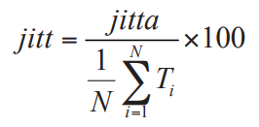
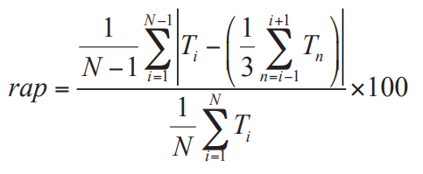
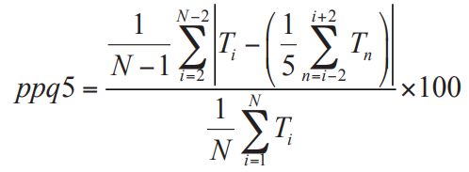
How are they computed?
Jitter
Jitter(local, absolute) jitta :
Jitter(local) jitt :
Jitter(rap) :
Jitter(ppq5) :

Slide 6
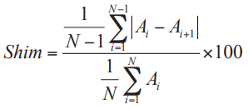

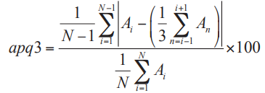
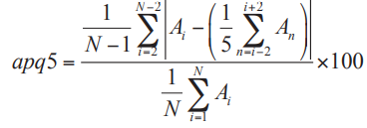
How are they computed?
Shimmer
Shimmer(local) shim :
Shimmer(local, dB) shdB :
Shimmer(apq3) :
Shimmer(apq5) :

Slide 7
How does it changes across age, gender?
There is a typical range of values of fundamental frequency for the different genders and ages.
In relation to the fundamental frequency (F₀), higher values of F₀ are reported for women than for men, with variations according to age for both genders.

Slide 8
How does it changes across age, gender?
Vocal changes due to advancing age can be identified acoustically at the end of adulthood and, in women these changes can be marked particularly before the menopause period and in men, an increase in shimmer measure was observed with the advancing age.
In relation to age, women present modifications in the F₀ measure of the vowel and speech, and in men, the beginning of the vocal modifications are indicated by the F₀ measure of speech and Shimmer

Slide 9
How it changes in stuttering?
Significant changes between stutters and non-stutters can be observed mainly in the shimmer
Although there is some changes in the jitter, it isn't as significant.
Let us consider a case study where the vocal jitter and shimmer measures of the fluent phonation of 14 stutterers, 12 male and two female, were compared with jitter and shimmer measures of a group of non-stutterers matched for age and sex

Slide 10
THANK YOU!

